Slide 1
PO-AP Interface
Test Case — PO 5985471
Oracle EBS R12.2 | Receipt-to-Invoice & RTV-to-Credit-Memo Interface
Test Date: 29-Apr-2026 | Run IDs: INV-20260429122004 / RTV-20260429122055

Slide 2
Agenda
1. Test Overview & Pre-Conditions
2. Process A — Receipt-to-Invoice
3. RTV Netting — Line 75 (Key Scenario)
4. Process B — RTV-to-Credit-Memo
5. Duplicate Prevention
6. EBS UI Evidence — Standard Invoice
7. EBS UI Evidence — Credit Memo
8. Summary & Net AP Balance
PO-AP Interface | Test Case PO 5985471 | Oracle EBS R12.2

Slide 3
Test Overview
PO 5985471 — BLANKET PO, Vendor 13001, Currency INR
Field | Value
PO Number | 5985471
PO Type | BLANKET
Vendor ID / Site | 13001 / 14023
Currency | INR
Legacy PO Header ID | 6443887
Total Releases | 5,558 across 104 lines
Unbilled w/ Receipts | 35
RTVs | 1 (Line 75, qty=10)
Pre-Conditions
• PO exists in legacy with cancel_flag = 'N'
• Vendor 13001 present in new AP_SUPPLIERS
• 43 releases have qty_billed < qty_ordered
• 35 of 43 have at least 1 RECEIVE transaction
• 1 RETURN TO VENDOR on Line 75 (qty=10, 02-Apr-26)
PO-AP Interface | Test Case PO 5985471 | Oracle EBS R12.2

Slide 4
Process A — Receipt-to-Invoice
Creates STANDARD AP Invoices from PO Receipts
Test | Description | Expected | Result
TC-A1 | Invoices created | 35 STANDARD invoices | ✓
TC-A1 | Log status | 35 × PROCESSED | ✓
TC-A1 | Errors / Rejects | 0 | ✓
TC-A2 | Fully billed excluded | 5,515 releases skipped | ✓
TC-A3 | RTV netting — Line 75 | Net qty = 1,490 | ✓
TC-A4 | Standard invoice — Line 4 | STANDARD, amt = 6,234.64 | ✓
Key rule: quantity_billed < quantity_ordered filter ensures only unbilled releases are invoiced.
PO-AP Interface | Test Case PO 5985471 | Oracle EBS R12.2

Slide 5
RTV Netting — Line 75 (KODUBALE 30 GM)
TC-A3: Pre-invoice RTV netted from receipt quantity
RECEIVE
01-Apr-26
Qty = 1,500
RTV
02-Apr-26
Qty = 10
Net Qty
1,500 − 10
= 1,490
Invoice
RCPT-6797774-L075
STANDARD
→
→
→
Component | Calculation | Amount (INR)
ITEM line | 1,490 × 7.11 | 10,593.90
CGST 2.5% | 10,593.90 × 2.5% | 266.63
SGST 2.5% | 10,593.90 × 2.5% | 266.63
Total Invoice |  | 11,127.16
Invoice description includes: "Net of RTV: 10"
PO-AP Interface | Test Case PO 5985471 | Oracle EBS R12.2

Slide 6
Process B — RTV-to-Credit-Memo
Post-invoice RTVs generate CREDIT type invoices
Test Results
Credit Memo Breakdown
Test | Expected | Result
TC-B1: Credit Memo created | 1 CREDIT invoice | ✓
TC-B1: Invoice num | CM-RCPT-6797774-L075 | ✓
TC-B1: References original | Desc: Original Invoice: … | ✓
TC-B2: Header amount | -74.66 | ✓
TC-B2: ITEM line | -71.10, qty=10 | ✓
TC-B2: CGST line | -1.78 | ✓
TC-B2: SGST line | -1.78 | ✓
TC-B3: Scenario A skips | 0 | ✓
Line | Type | Amount (INR) | CCID
75 | ITEM | -71.10 | 5028
7501 | TAX | -1.78 | 5028
7502 | TAX | -1.78 | 5028
HDR | TOTAL | -74.66 | —
RTV qty = 10 | Unit price = 7.11 | CGST/SGST 2.5% each
PO-AP Interface | Test Case PO 5985471 | Oracle EBS R12.2

Slide 7
Duplicate Prevention
Re-running either process must not create duplicate records
Test | Action | Expected | Result
TC-D1 | Re-run Process A | 0 new invoices; 35 REJECTED as duplicate | ✓
TC-D2 | Re-run Process B | 0 new credit memos; RTV REJECTED as duplicate | ✓
How it works
• Process A checks AP_INVOICES_INTERFACE for existing invoice_num before inserting.
• Process B checks for existing CM-prefixed invoice_num before creating a credit memo.
• Both processes log REJECTED status with reason in XXCUST_PO_AP_INTERFACE_LOG.
PO-AP Interface | Test Case PO 5985471 | Oracle EBS R12.2

Slide 8
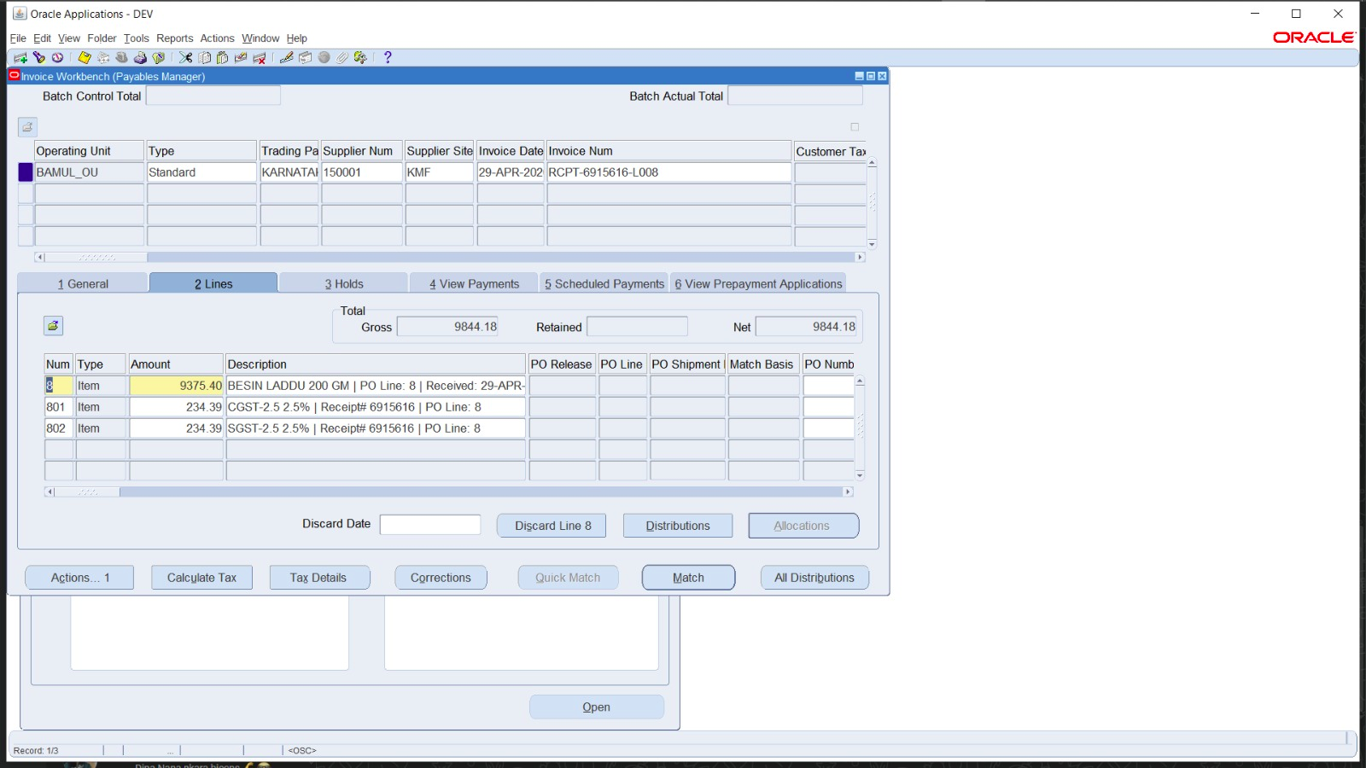
EBS UI — Standard Invoice (Process A)
Oracle AP module showing imported STANDARD invoice for PO 5985471
Invoice RCPT-6797774-L075 | Type: STANDARD | Amount: 11,127.16 INR | Status: Validated
PO-AP Interface | Test Case PO 5985471 | Oracle EBS R12.2

Slide 9
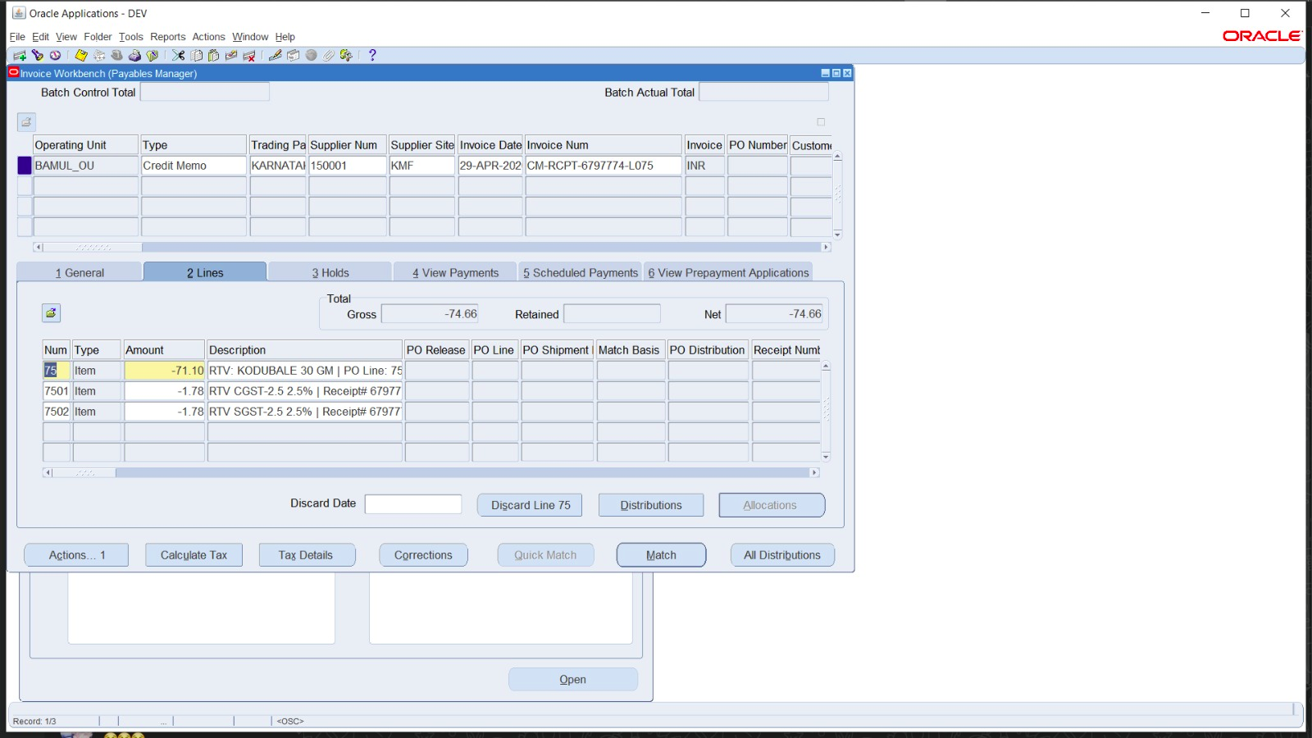
EBS UI — Credit Memo / Return Invoice (Process B)
Oracle AP module showing CREDIT invoice created for post-invoice RTV
Invoice CM-RCPT-6797774-L075 | Type: CREDIT | Amount: -74.66 INR | References original invoice
PO-AP Interface | Test Case PO 5985471 | Oracle EBS R12.2

Slide 10
Summary — Test Results
All test cases passed for PO 5985471
Metric | Expected | Actual | Match?
Process A: Invoices processed | 35 | 35 | ✓
Process A: Total amount (INR) | 1,608,217.37 | 1,608,217.37 | ✓
Process A: Rejected | 0 | 0 | ✓
Process A: Skipped | 0 | 0 | ✓
Process B: Credit Memos processed | 1 | 1 | ✓
Process B: Credit Memo amount (INR) | 74.66 | 74.66 | ✓
Process B: Skipped (Scenario A) | 0 | 0 | ✓
Net AP Balance (INR) | 1,608,142.71 | 1,608,142.71 | ✓
Net AP Balance = 1,608,217.37 − 74.66 = 1,608,142.71 INR
PO-AP Interface | Test Case PO 5985471 | Oracle EBS R12.2

